Slide 1
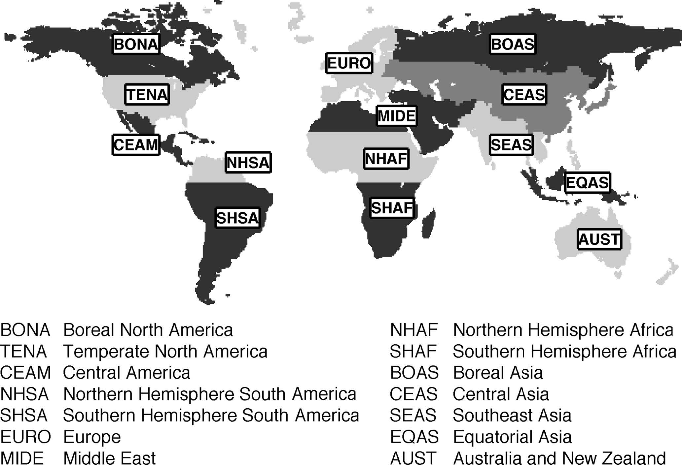
1:
2:
3:
4:
5:
6:
7:
8:
9:
10:
11:
12:
13:
14:

Slide 2
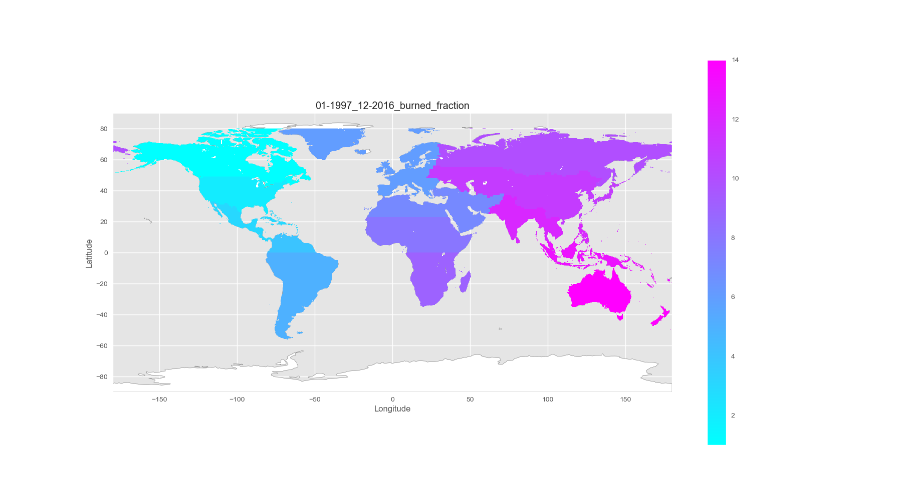
1-BONA
6-EURO
10-BOAS
11-CEAS
2-TENA
7-MIDE
3-CEAM
12-SEAS
8-NHAF
4-NHSA
13-EQAS
9-SHAF
5-SHSA
14-AUST

